Slide 1

Data Structures and Abstractions with Java
Chapter 25
Tree Implementations

Slide 2
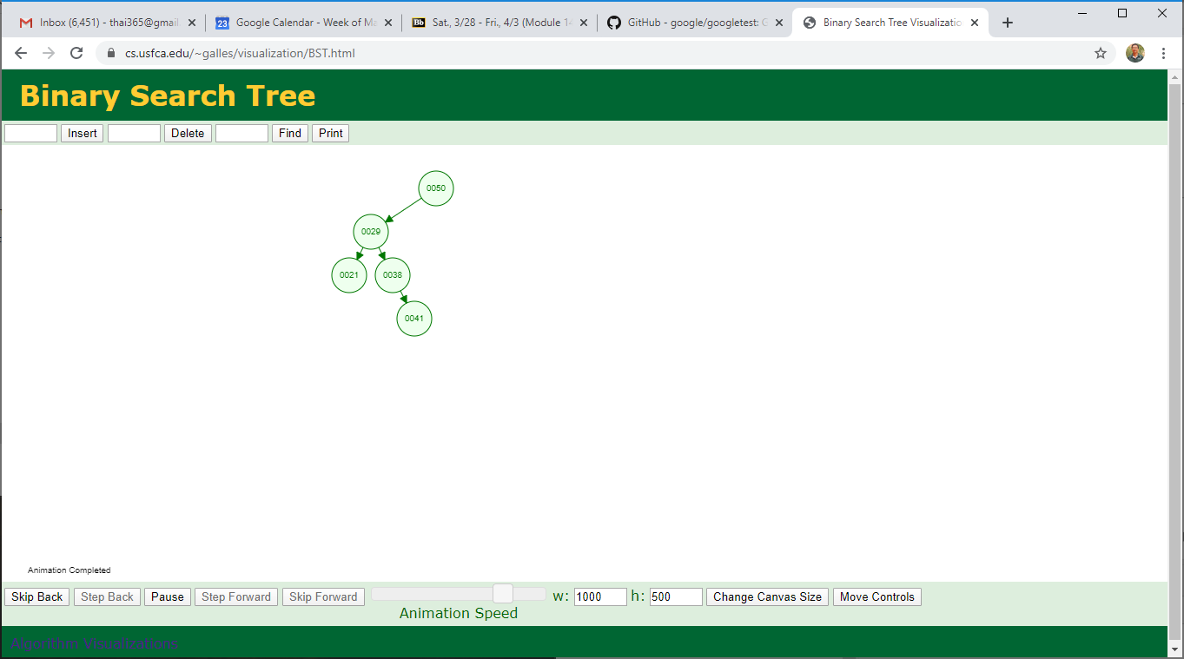
Review | Example
Reconstruct the tree
[50, 29, 38, 21, 41]
Reconstruct a tree from 1+ traversals
What type of tree is this, Binary or BST?
Is it a heap?
Notes:
Binary vs. binary search trees?
Is this a heap?

Slide 3
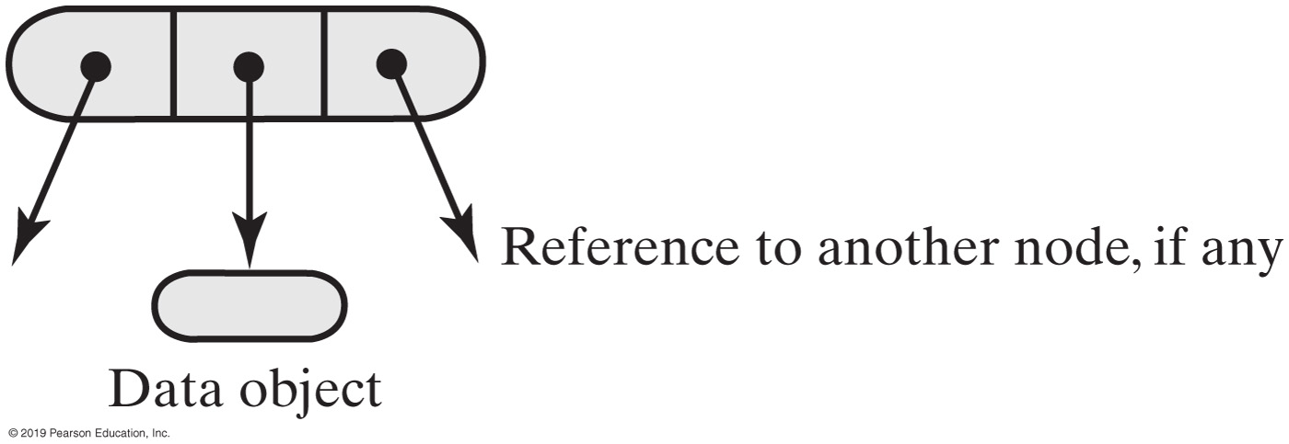
Binary Tree Nodes
Notes:
Characteristics of a binary tree node

Slide 4
Binary Tree Node (1 of 4)
/** A class that represents nodes in a binary tree. */
class BinaryNode<T>
{
private T data;
private BinaryNode<T> leftChild; // Reference to left child
private BinaryNode<T> rightChild; // Reference to right child
public BinaryNode()
{
this(null); // Call next constructor
} // end default constructor
public BinaryNode(T dataPortion)
{
this(dataPortion, null, null); // Call next constructor
} // end constructor
public BinaryNode(T dataPortion, BinaryNode<T> newLeftChild,
BinaryNode<T> newRightChild)
{
data = dataPortion;
leftChild = newLeftChild;
rightChild = newRightChild;
} // end constructor
Notes:
Tree vs. Node (classes)

Slide 5
Binary Tree Node (2 of 4)
/** Retrieves the data portion of this node.
@return The object in the data portion of the node. */
public T getData(). {
return data;
} // end getData
/** Sets the data portion of this node.
@param newData The data object. */
public void setData(T newData) {
data = newData;
} // end setData
/** Retrieves the left child of this node.
@return A reference to this node's left child. */
public BinaryNode<T> getLeftChild()
{
return leftChild;
} // end getLeftChild
/** Sets this node’s left child to a given node.
@param newLeftChild A node that will be the left child. */
public void setLeftChild(BinaryNode<T> newLeftChild)
{
leftChild = newLeftChild;
} // end setLeftChild

Slide 6
Binary Tree Node (3 of 4)
/** Detects whether this node has a left child.
@return True if the node has a left child. */
public boolean hasLeftChild()
{
return leftChild != null;
} // end hasLeftChild
/* Implementations of getRightChild, setRightChild, and hasRightChild
are here and are analogous to their left-child counterparts. */
/** Detects whether this node is a leaf.
@return True if the node is a leaf. */
public boolean isLeaf()
{
return (leftChild == null) && (rightChild == null);
} // end isLeaf
/** Counts the nodes in the subtree rooted at this node.
@return The number of nodes in the subtree rooted at this node. */
public int getNumberOfNodes()
{
// < Coming later —— See Segment 25.10. >
} // end getNumberOfNodes

Slide 7
Binary Tree Node (4 of 4)
/** Computes the height of the subtree rooted at this node.
@return The height of the subtree rooted at this node. */
public int getHeight()
{
// < Coming later —- See Segment 25.10. >
} // end getHeight
/** Copies the subtree rooted at this node.
@return The root of a copy of the subtree rooted at this node. */
public BinaryNode<T> copy()
{
// < Coming later —— See Segment 25.5. >
} // end copy
} // end BinaryNode
All “right child” methods are missing (from these slides)
Notes:
All “right child” methods are missing (from these slides)

Slide 8
getHeight()
public int getHeight()
{
return getHeight(this); // Call private getHeight
} // end getHeight
private int getHeight(BinaryNode<T> node)
{
int height = 0;
if (node != null)
height = 1 + Math.max(getHeight(node.getLeftChild()),
getHeight(node.getRightChild()));
return height;
}

Slide 9
getNumberOfNodes()
public int getNumberOfNodes()
{
int leftNumber = 0;
int rightNumber = 0;
if (left != null)
leftNumber = left.getNumberOfNodes();
if (right != null)
rightNumber = right.getNumberOfNodes();
return 1 + leftNumber + rightNumber;
} // end getNumberOfNodes

Slide 10
Binary Tree | Interface
/** An interface for the ADT binary tree. */
public interface BinaryTreeInterface<T> extends TreeInterface<T>,
TreeIteratorInterface<T>
{
/** Sets the data in the root of this binary tree.
@param rootData The object that is the data for the tree's root.
*/
public void setRootData(T rootData);
/** Sets this binary tree to a new binary tree.
@param rootData The object that is the data for the new tree's root.
@param leftTree The left subtree of the new tree.
@param rightTree The right subtree of the new tree. */
public void setTree(T rootData, BinaryTreeInterface<T> leftTree,
BinaryTreeInterface<T> rightTree);
} // end BinaryTreeInterface

Slide 11
Creating a Basic Binary Tree (Part 1)
import java.util.Iterator;
import java.util.NoSuchElementException;
import StackAndQueuePackage.*; // Needed by tree iterators
/** A class that implements the ADT binary tree. */
public class BinaryTree<T> implements BinaryTreeInterface<T>
{
private BinaryNode<T> root;
public BinaryTree()
{
root = null;
} // end default constructor
public BinaryTree(T rootData)
{
root = new BinaryNode<>(rootData);
} // end constructor
public BinaryTree(T rootData, BinaryTree<T> leftTree, BinaryTree<T> rightTree)
{
initializeTree(rootData, leftTree, rightTree);
} // end constructor

Slide 12
Creating a Basic Binary Tree (Part 2)
public void setTree(T rootData, BinaryTreeInterface<T> leftTree,
BinaryTreeInterface<T> rightTree)
{
initializeTree(rootData, (BinaryTree<T>)leftTree,
(BinaryTree<T>)rightTree);
} // end setTree
private void initializeTree(T rootData, BinaryTree<T> leftTree,
BinaryTree<T> rightTree)
{
// < FIRST DRAFT - See Segments 25.4 - 25.7 for improvements. >
root = new BinaryNode<T>(rootData);
if (leftTree != null)
root.setLeftChild(leftTree.root);
if (rightTree != null)
root.setRightChild(rightTree.root);
} // end initializeTree
/* Implementations of setRootData, getRootData, getHeight, getNumberOfNodes,
isEmpty, clear, and the methods specified in TreeIteratorInterface are here.
. . . */
} // end BinaryTree

Slide 13
The Method copy
/** Copies the subtree rooted at this node. */
public BinaryNode<T> copy()
{
BinaryNode<T> newRoot = new BinaryNode<>(data);
if (leftChild != null)
newRoot.setLeftChild(leftChild.copy());
if (rightChild != null)
newRoot.setRightChild(rightChild.copy());
return newRoot;
} // end copy

Slide 14
The Method initializeTree
private void initializeTree(T rootData, BinaryTree<T> leftTree, BinaryTree<T> rightTree)
{
root = new BinaryNode<>(rootData);
if ((leftTree != null) && !leftTree.isEmpty())
root.setLeftChild(leftTree.root.copy());
if ((rightTree != null) && !rightTree.isEmpty())
root.setRightChild(rightTree.root.copy());
} // end initializeTree
Method initializeTree can invoke copy to copy the nodes from the two given subtrees

Slide 15
BinaryTree Accessor and Mutator Methods
public void setRootData(T rootData)
{
root.setData(rootData);
} // end setRootData
public T getRootData()
{
if (isEmpty())
throw new EmptyTreeException();
else
return root.getData();
} // end getRootData
protected void setRootNode(BinaryNode<T> rootNode)
{
root = rootNode;
} // end setRootNode
protected BinaryNode<T> getRootNode()
{
return root;
} // end getRootNode

Slide 16
Traversals That Use An Iterator (Part 1)
private class InorderIterator implements Iterator<T>
{
private StackInterface<BinaryNode<T>> nodeStack;
private BinaryNode<T> currentNode;
public InorderIterator()
{
nodeStack = new LinkedStack<>();
currentNode = root;
} // end default constructor
public void remove()
{
throw new UnsupportedOperationException();
} // end remove
public boolean hasNext()
{
return !nodeStack.isEmpty() || (currentNode != null);
} // end hasNext

Slide 17
Traversals That Use An Iterator (Part 2)
public T next()
{
BinaryNode<T> nextNode = null;
// Find leftmost node with no left child
while (currentNode != null)
{
nodeStack.push(currentNode);
currentNode = currentNode.getLeftChild();
} // end while
// Get leftmost node, then move to its right subtree
if (!nodeStack.isEmpty())
{
nextNode = nodeStack.pop();
// Assertion: nextNode != null, since nodeStack was not empty
// before the pop
currentNode = nextNode.getRightChild();
}
else
throw new NoSuchElementException();
return nextNode.getData();
} // end next
} // end InorderIterator

Slide 18
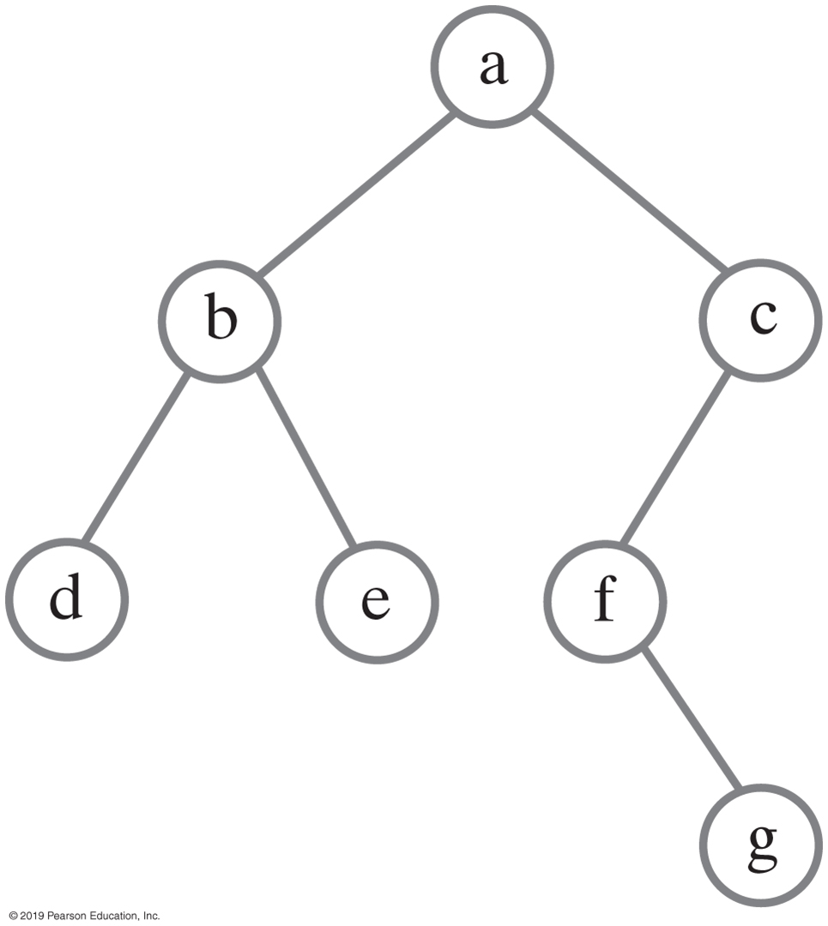
Traversing a binary tree recursively
public void inorderTraverse()
{
inorderTraverse(root);
} // end inorderTraverse
private void inorderTraverse(BinaryNode<T> node)
{
if (node != null)
{
inorderTraverse(node.getLeftChild());
System.out.println(node.getData());
inorderTraverse(node.getRightChild());
} // end if
} // end inorderTraverse

Slide 19
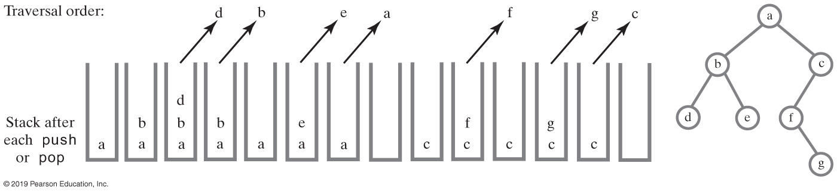
Non-recursive Traversal
Using a stack to perform an in-order traversal of a binary tree

Slide 20
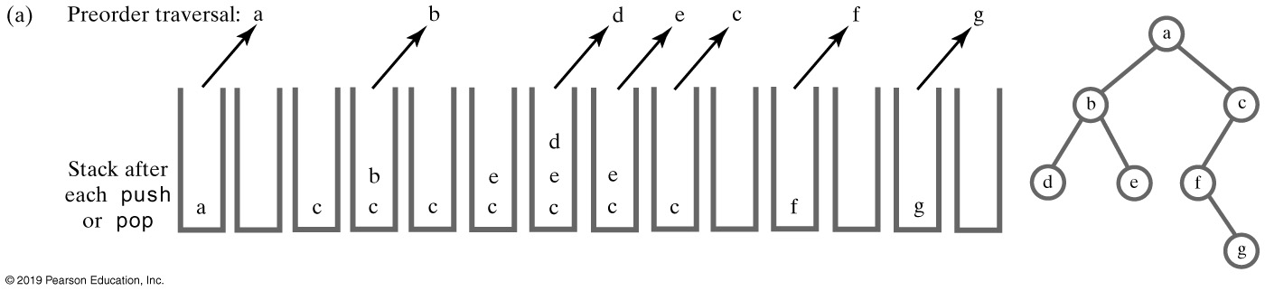
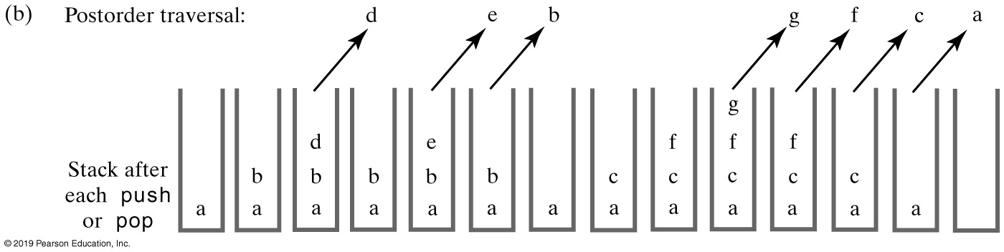
Using a Stack to Traverse a Binary Tree

Slide 21
Non-recursive Traversal
public void iterativeInorderTraverse()
{
StackInterface<BinaryNode<T>> nodeStack = new LinkedStack<>();
BinaryNode<T> currentNode = root;
while (!nodeStack.isEmpty() || (currentNode != null))
{
// Find leftmost node with no left child
while (currentNode != null)
{
nodeStack.push(currentNode);
currentNode = currentNode.getLeftChild();
} // end while
// Visit leftmost node, then traverse its right subtree
if (!nodeStack.isEmpty())
{
BinaryNode<T> nextNode = nodeStack.pop();
// Assertion: nextNode != null, since nodeStack was not empty
// before the pop
System.out.println(nextNode.getData());
currentNode = nextNode.getRightChild();
} // end if
} // end while
} // end iterativeInorderTraverse

Slide 22
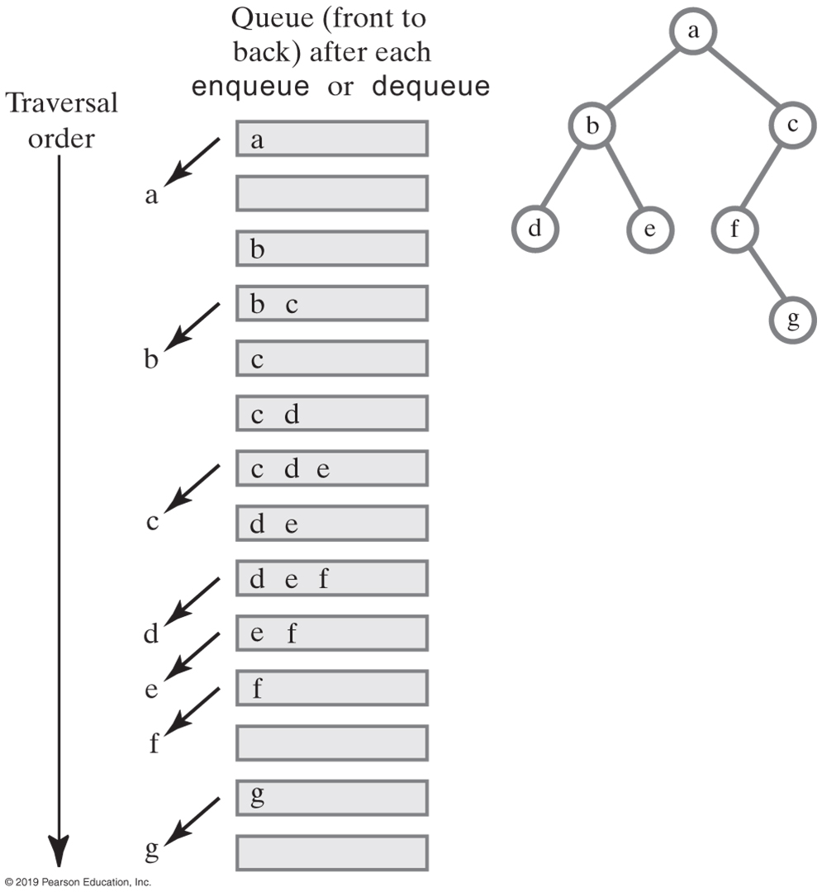
Using a Queue for Level-Order Traversal

Slide 23
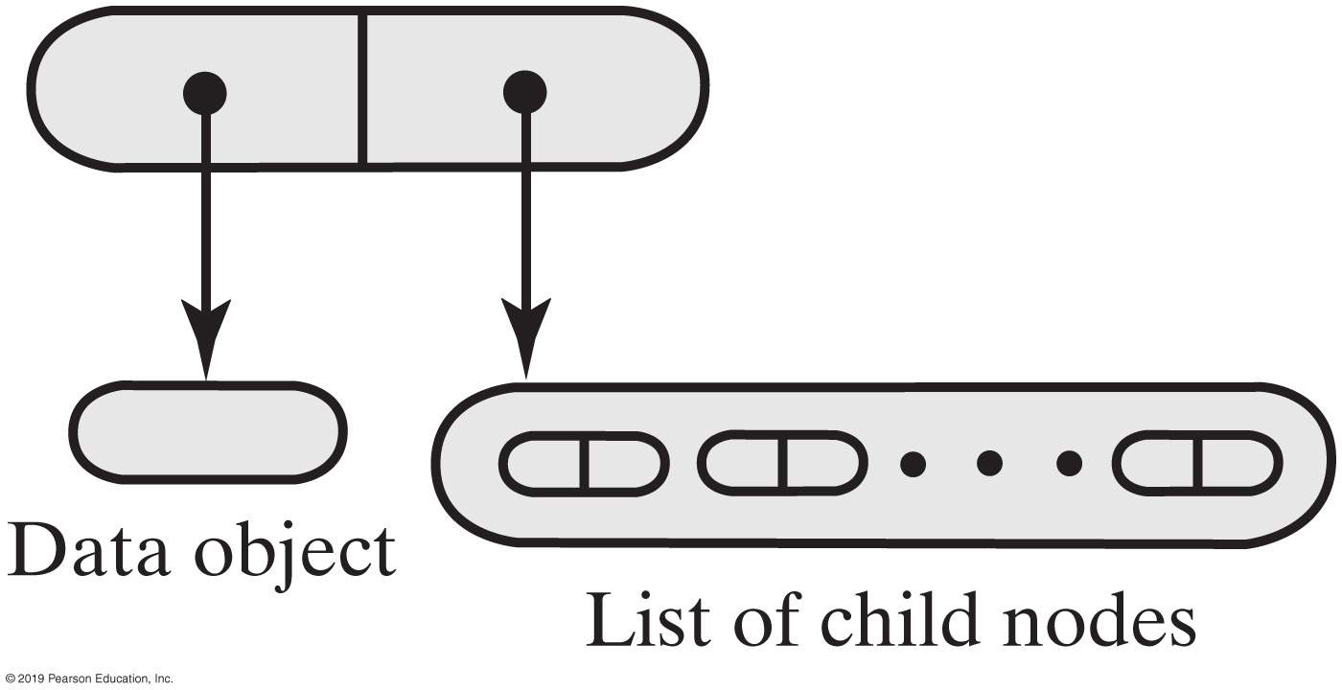
Representing General Trees
A node for a general tree

Slide 24
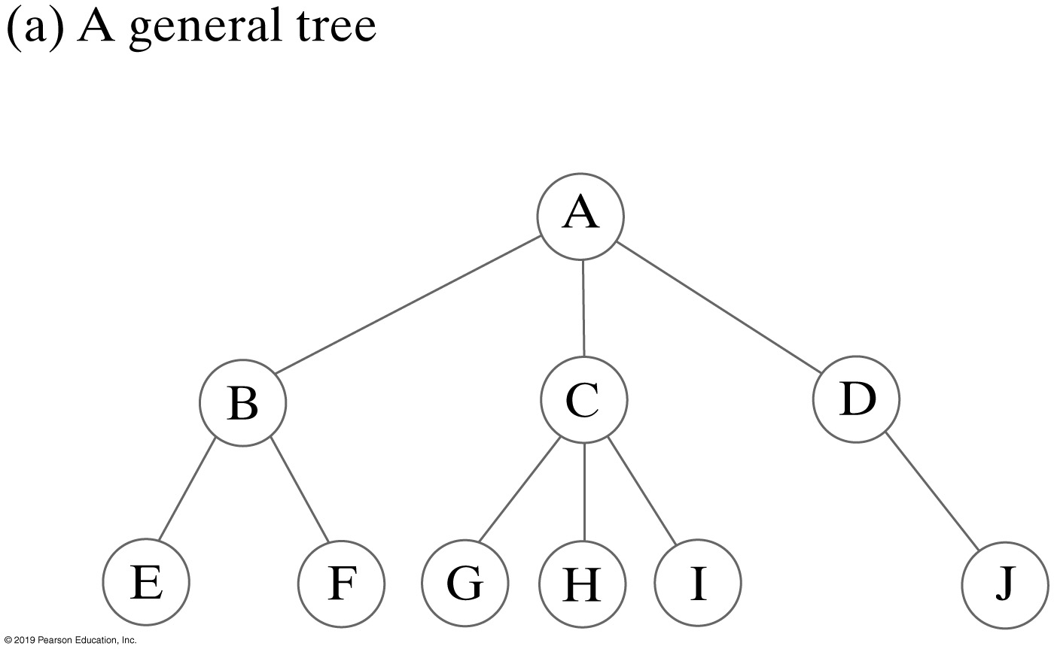
Representing General Trees

Slide 25
Representing General Trees
import java.util.Iterator;
/** An interface for a node in a general tree.*/
interface GeneralNodeInterface<T>
{
public T getData();
public void setData(T newData);
public boolean isLeaf();
public Iterator<GeneralNodeInterface<T>> getChildrenIterator();
public void addChild(GeneralNodeInterface<T> newChild);
} // end GeneralNodeInterface

